Slide 1
4-Week Research Update: Fun with Glass!
Jackie Loven
10 July 2017

Slide 2
Recall
Crack fraction: total cracks/ total indentation corners
Hardness: load/ observed area of indent
Crack threshold: load at which cracks appear
Pileup: plastically deformed material pushed up around indent

Slide 3
Current Problems
Calcium aluminosilicates aren’t that well characterized
fracture properties
hardness
But these test measurements are super subjective

Slide 4
Recent Projects
Taking measurements
crack fraction
hardness
crack threshold over time
pileup
Characterizing error in measurements
Making indent edges clearer

Slide 5
Collecting Data

Slide 6
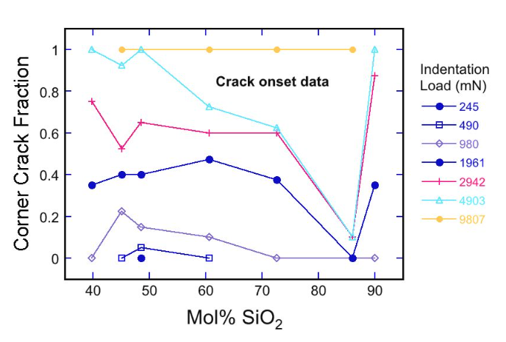
Initial observations
Caila’s data from last year:

Slide 7
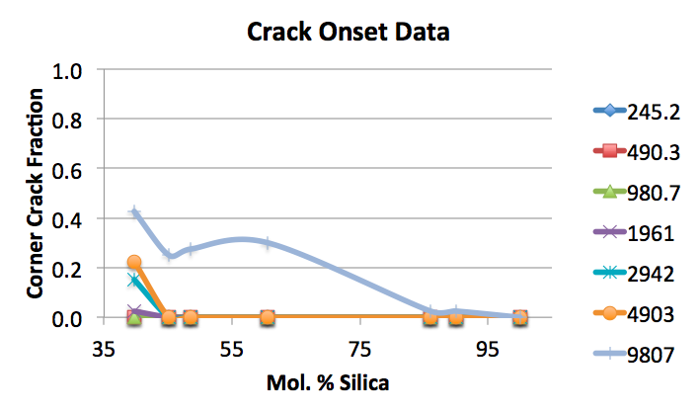
Initial observations
My data was very different

Slide 8
The Culprit: Time?
Samples photographed immediately after indenting and after 1 week

Slide 9
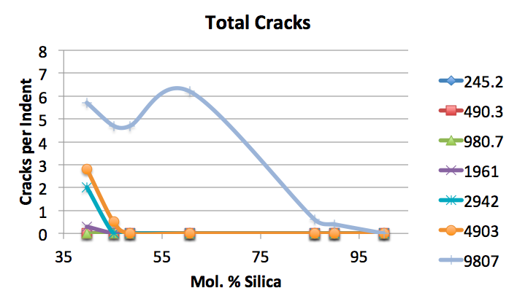
The Culprit: Time?
Before:

Slide 10
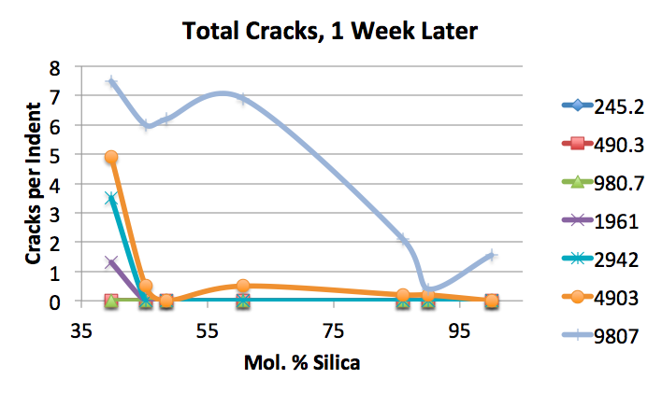
The Culprit: Time?
After: cracks appear over time

Slide 11
Also The Culprit: Surface Roughness?
3 Samples
0.05 µm polish
0.5 µm polish
1 µm polish
Roughness data from profiles
Caila’s samples: Looked inconclusive (actual: 1 µm polish)
My samples: Looked between 0.5 µm and 1 µm (actual: 0.5 µm polish)

Slide 12
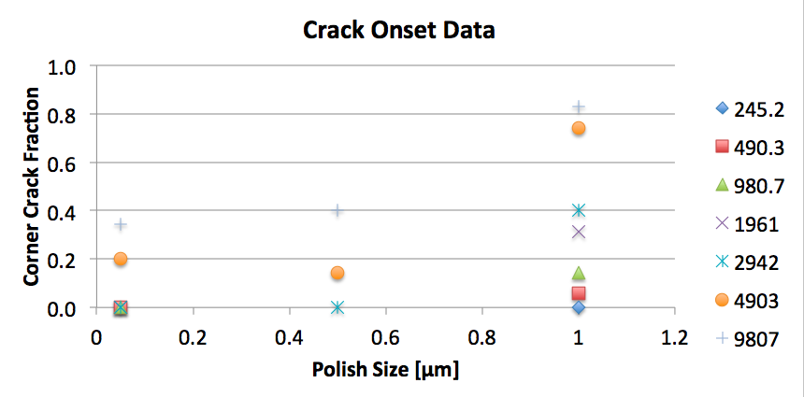
Also The Culprit: Surface Roughness?
Roughness changes crack fraction

Slide 13
Sample Differences
Time: affects crack threshold
Surface polish level: affects cracks but not hardness

Slide 14
Quantifying Error

Slide 15
Laser Profiler Error
Laser profiler can’t measure small indents, pileup
AFM should show what small indents and pileup actually look like
A linear correction factor between laser profiler and AFM would be fantastic
But AFM results are wonky

Slide 16
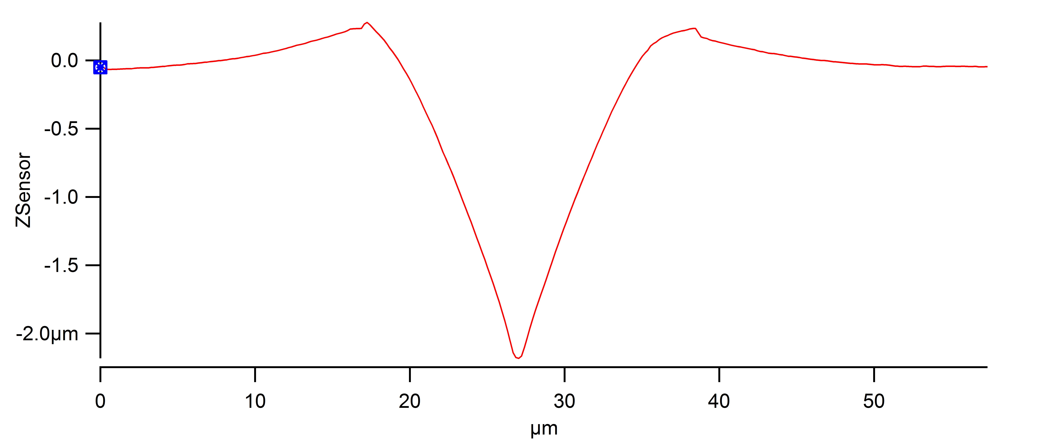
AFM Results
Laser profiler says this 2 µm deep indent is 4 µm deep!

Slide 17
AFM Results
Not even close to square!
How to fix?

Slide 18
Making Indent Edges Clearer

Slide 19
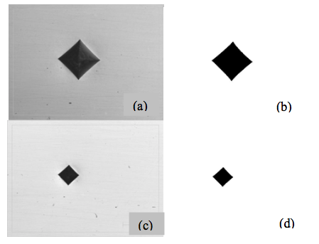
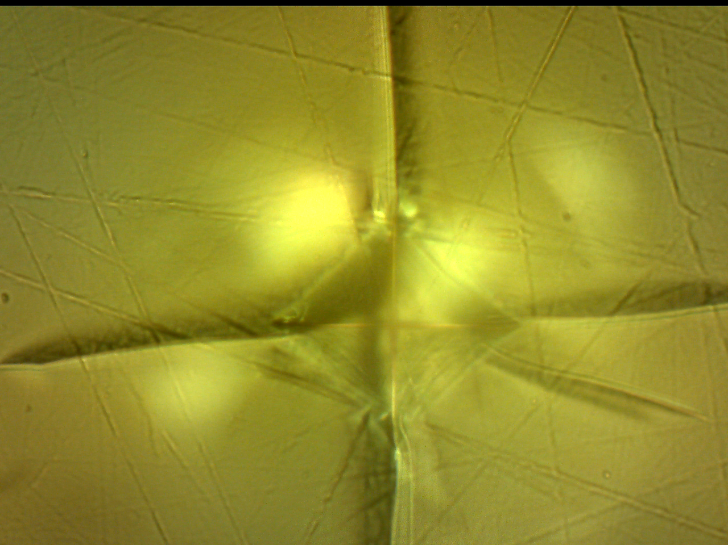
Traditional Hardness Error
Indents in metal samples are gorgeous. Ours? Not so much.
vs.

Slide 20
Traditional Hardness Error
For small indents/ groups without a laser profiler:
Indent measurements are super subjective
Can we make measurements easier?

Slide 21
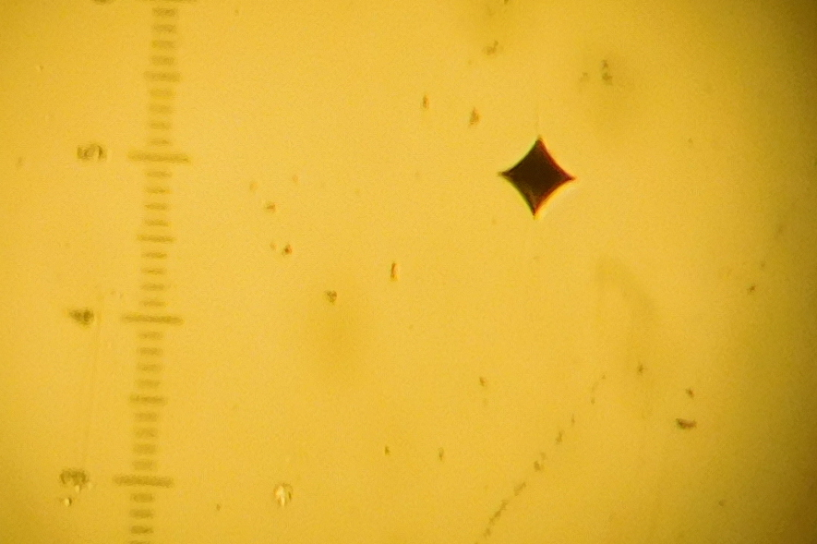
Traditional Hardness Error
Make the samples look like metal
Carbon and gold didn’t work too well, but gold-palladium is great

Slide 22
Future Work
Get better AFM data
Get accurate hardness vs. load data
Take nice images of coated indents, see how much the coating changes the programatically determined area

Slide 23
Questions

